Slide 1



LRGASP: Performance evaluation in Challenge 2
Kin Fai Au, Dingjie Wang and Haoran Li
On behalf of the LRGASP evaluation team
03/03/2022

Slide 2
Outline
  Overview of submitted results and evaluation metrics
  Evaluation in real data (WTC11, H1-mix, H1-hESC and H1-DE)
  Evaluation in SIRV and simulation data

Slide 3
Part I.
Overview of submitted results and evaluation metrics

Slide 4


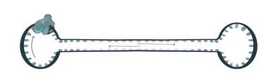

The LRGASP Challenge 2: Transcript quantification
Sample types
Library protocols
Sequencing
platforms
WTC11
cDNA
Sequel II
direct RNA
H1-hESC
H1-DE
H1-mix
R2C2
MinION
synthetic data
Simulation data
CapTrap
Notes:
H1-hESC:H1 human embryonic stem cell line
H1-DE: H1 definitive endoderm(en·duh·drm)
H1-mix: mixture of H1-hESC and H1-DE

Slide 5
Overview of submission results in Challenge 2
7 tools with 127 submission results
Library protocols
Sequencing platforms
Notes:
long reads only
More ONT , cDNA
Isoquant, Talon submitted the results of all protocols and platforms

Slide 6
Complexity of annotations in different tools
Notes:
Nanosim -> gencode,Bambu: GENCODE+identified ,
Other used long reads annotation
RSEM: GENCODE

Slide 7
Performance measures for different data types
Different Data Types
Raw real data
Synthetic data
Simulation data
Multiple replicates
(no ground truth)
Cell mixture data
(expected vs observed)
SIRV data
(ground truth is available)
Single replicate data
(ground truth is available)
Evaluation metrics
Statistical measures
Irreproducibility
Correlation
ARR
Consistency
NRMSE
Resolution Entropy
MRD

Slide 8
Performance measures for different data types
Different Data Types
Raw real data
Synthetic data
Simulation data
Multiple replicates
(no ground truth)
Cell mixture data
(expected vs observed)
SIRV data
(ground truth is available)
Single replicate data
(ground truth is available)
Evaluation metrics
Statistical measures
Irreproducibility
Correlation
ARR
Consistency
NRMSE
Resolution Entropy
MRD

Slide 9
Performance measures for different data types
Different Data Types
Raw real data
Synthetic data
Simulation data
Multiple replicates
(no ground truth)
Cell mixture data
(expected vs observed)
SIRV data
(ground truth is available)
Single replicate data
(ground truth is available)
Statistical measures
Irreproducibility
Correlation
ARR
Consistency
NRMSE
Resolution Entropy
MRD

Slide 10
Part II.
Evaluation in real data (WTC11, H1_mix, H1-hESC and H1-DE)

Slide 11
Performance measures for different data types
Different Data Types
Raw real data
Synthetic data
Simulation data
Multiple replicates
(no ground truth)
Cell mixture data
(expected vs observed)
SIRV data
(ground truth is available)
Single replicate data
(ground truth is available)
Statistical measures
Irreproducibility
Correlation
ARR
Consistency
NRMSE
Resolution Entropy
MRD

Slide 12
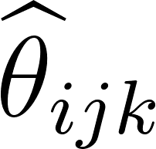

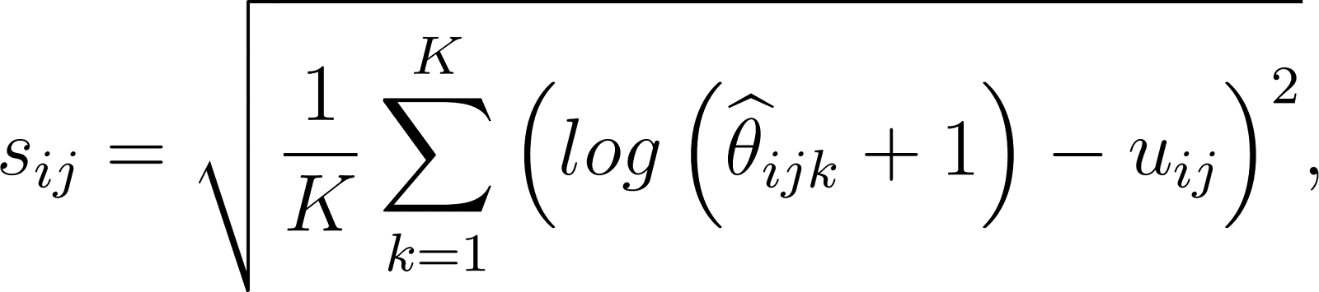
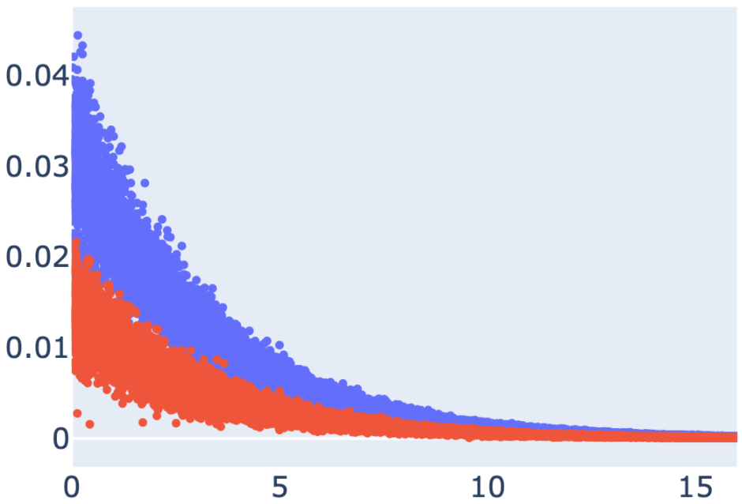
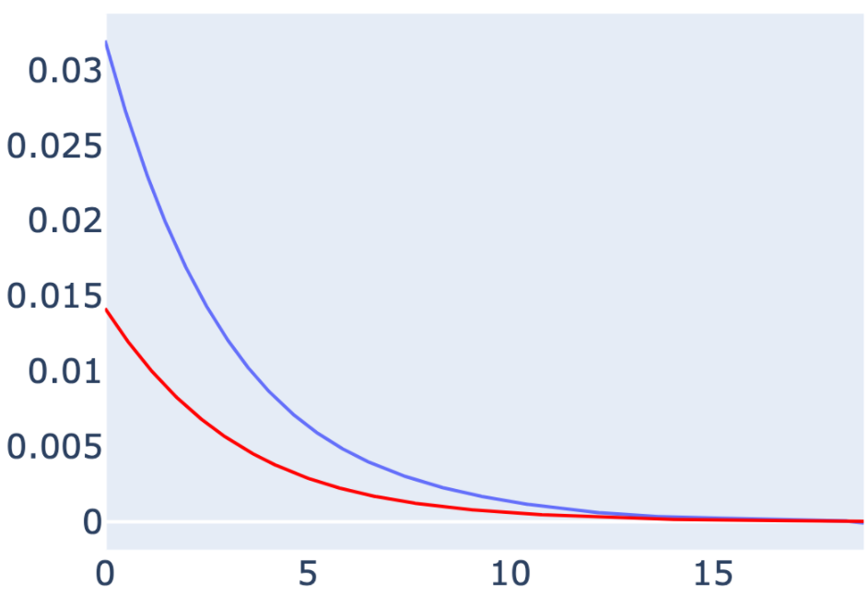
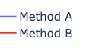
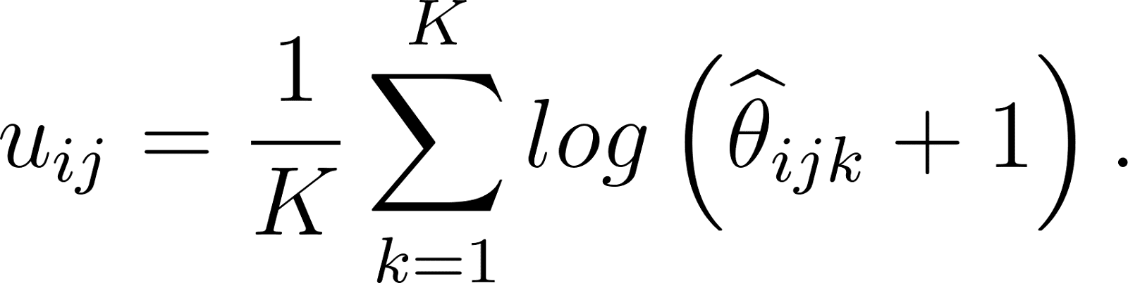
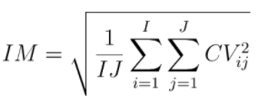
Irreproducibility and ACVC
Denote as the abundance estimation of transcript (i=1,2, …, I) in a sample, where j (j=1,2) represents different groups (i.e., conditions or tissues) and k (k=1,2, …, K) represents different replicates within the group.
Plot CV_{ij} versus average abundance u_{ij}
We can plot CV_{ij} versus average abundance u_{ij} to examine how CV changes with respect to the abundance and the area under the CV curve (ACVC) is calculated as a secondary statistic.
Coefficient of variation CV_{ij} of log 𝜽_{ijk} (k=1,2, …,K)
With small values of these metrics, the method has less variance among different replicates
where s_{ij} and u_{ij} are the sample standard deviation and mean of abundance estimates.
Irreproducibility
Coefficient of Variation vs isoform Abundance
Coefficient of variation curves
Coefficient of variation
Coefficient of variation
Smooth
Irreproducibility measure based on CV_{ij}
Average transcript abundance
Average transcript abundance
Irreproducibility among different replicates. By fitting the coefficient of variation versus average isoform abundance into a smooth curve, it can be shown that Method B has lower coefficient of variation and lower irreproducibility.
Notes:
Explain the illustration figure

Slide 13
Irreproducibility and ACVC of different tools
Isoform-level
Gene-level
Notes:
FLAMES and IsoQuant has good irreproducibility. Gene level irreproducibility yields a lower irreproducibility compared to isoform level

Slide 14
Irreproducibility and ACVC of different protocols
Isoform-level
Gene-level
Notes:
CapTrap and cDNA better irreproducibility in isoform and gene level

Slide 15
Irreproducibility and ACVC of different platforms
Isoform-level
Gene-level
Notes:
SR has a overall better performance on irreproducibility than LR platforms. Pacbio slightly better than ONT

Slide 16
Irreproducibility Versus Isoform abundances (H1-hESC)
Irreproducibility
Log2(TPM+1)
Notes:
Abundance increases, irreproducibility
Low expressed isoform difficult to quantify/large variance

Slide 17
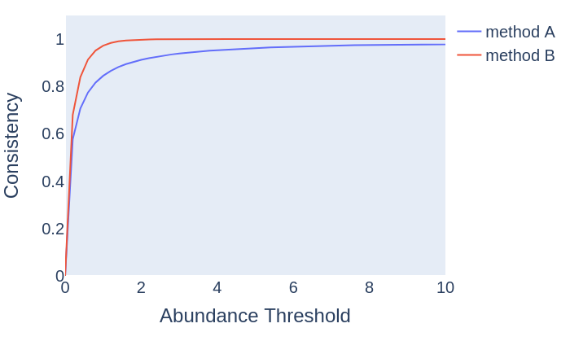
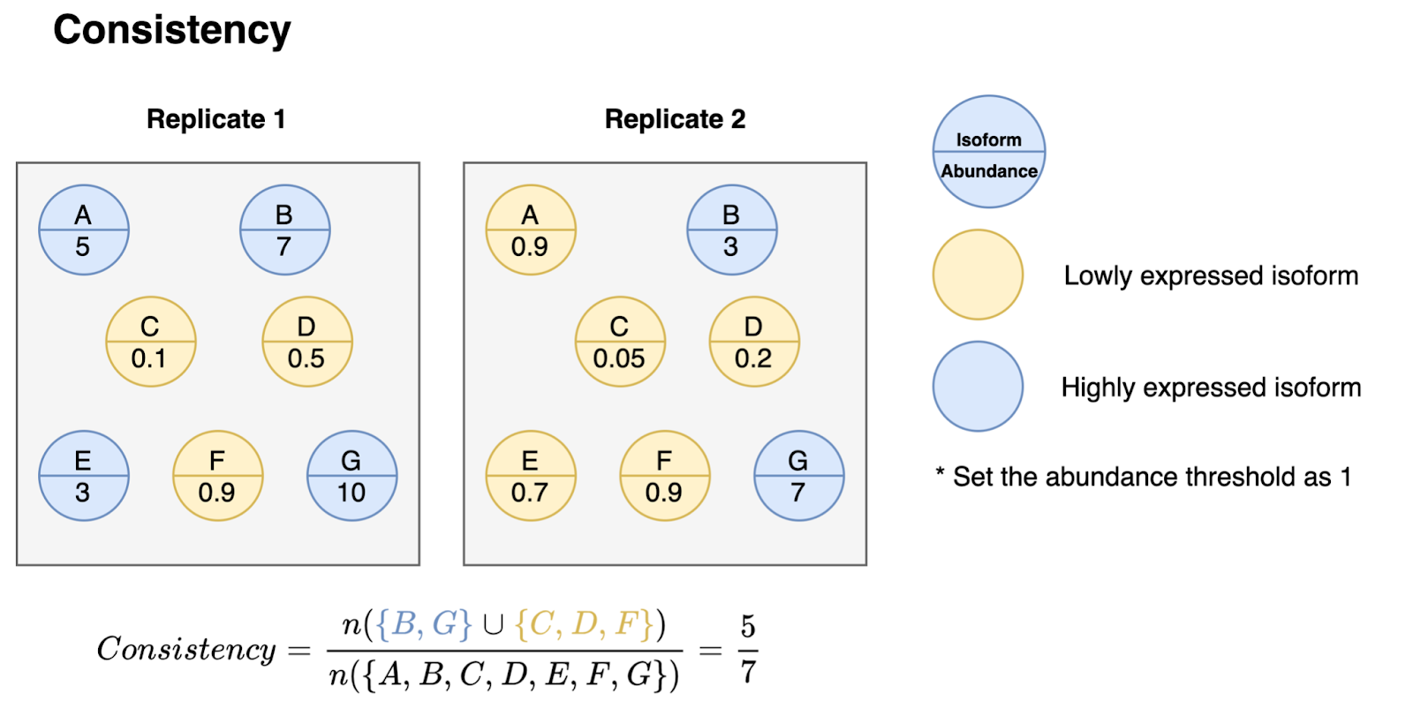
Consistency and ACC
A good quantification method tends to be the consistency of gene or isoform expression patterns in different replicates. Here we propose a consistency measure C(𝜶) to characterize the degree of similarity of gene or isoform expression in different replicates, which can be defined as follows:
Here,𝜶 is a threshold defining a transcript as expressed.
Plot abundance threshold 𝜶 versus consistency measure C(𝜶)
With a large value of these metrics, the method has a higher similarity of abundance estimates among multiple replicates.
Notes:
Explain the illustration

Slide 18
Consistency and ACC of different tools
Isoform-level
Gene-level
Notes:
Overall, isoquant and isotools have higher consistency and ACC in different platforms and protocols

Slide 19
Consistency and ACC of different protocols
Isoform-level
Gene-level
Notes:
cDNA and CapTrap achieves a higher performance regarding the consistency

Slide 20
Consistency and ACC of different platforms
Isoform-level
Gene-level
Notes:
Pacbio achieve a slighly higher consistency compared to ONT

Slide 21
Consistency Versus Isoform abundances (H1-hESC)
Consistency
Log2(TPM+1)
Notes:
Abundance increases, consistency increase to 1

Slide 22
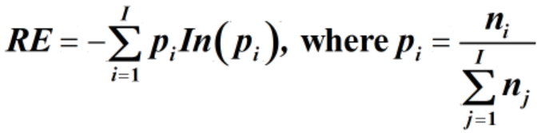
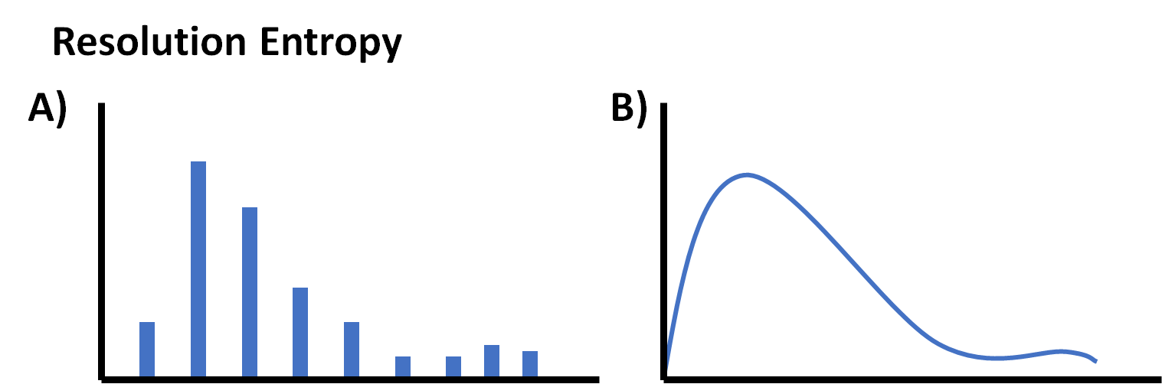
Resolution Entropy (RE)
As a good quantification method, it should have higher discrimination of gene/isoform abundance. Here, we propose a Resolution Entropy (RE) to characterize the resolution of gene/isoform abundance, which can be defined as:
Here, n_{i} represent the number of genes or isoforms with𝚯 𝟄 [i*𝝰, (i+1) *𝝰), and𝝰=max(𝚯)/I.
Resolution Entropy. (A) The software output only a few certain discrete values has lower resolution entropy as it cannot capture the continuous and subtle difference of gene expressions. (B) The software with continuous output values has higher resolution entropy.
Notes:
Illustration

Slide 23
RE in different tools, protocols and platforms
Notes:
Different platforms and protocols variability.
FLAMES have a higher resolution entropy.

Slide 24
Performance measures for different data types
Different Data Types
Raw real data
Synthetic data
Simulation data
Multiple replicates
(no ground truth)
Cell mixture data
(expected vs observed)
SIRV data
(ground truth is available)
Single replicate data
(ground truth is available)
Statistical measures
Irreproducibility
Correlation
ARR
Consistency
NRMSE
Resolution Entropy
MRD

Slide 25
Evaluation based on the cell mixture experiments
H1-hESC
H1-DE
H1-mix
0.8 *
+
0.2 *
=
Group 1: expected TPM
Group 2: observed TPM
Expectation: all isoforms have no differences across two groups.
Design strategies to evaluate the similarity of Group 1 and Group 2:
Correlation (SCC)
Median Relative Difference (MRD)
Normalized Root Mean Square Error (NRMSE)
Notes:
For real data evaluation, ground truth is not available. We design cell mixture experiements

Slide 26
Evaluate isoform expression using the cell mixing experiment
1.0
0.5
CapTrap_ONT
CapTrap_PacBio
cDNA_Illumina
cDNA_ONT
cDNA_PacBio
dRNA_ONT
R2C2_ONT
(TPM_{obs} – TPM_{exp})/TPM_{exp}
0.0
-0.5
-1.0
Bambu
FLAIR
FLAMES
IsoQuant
Talon/LAPA
IsoTools
NanoSim
RSEM
H1_mix: mix of H1-hESC and H1-DE cell at 0.8:0.2 ratio:
0.8*TPM_{H1-hESC} + 0.2*TPM_{H1-DE} ≈ expected TPM_{H1-mix}
TPM_{exp} = 0.8*TPM_{H1-hESC} + 0.2*TPM_{H1-DE}
TPM_{obs} = TPM_{H1-mix}
Notes:
Overall, IsoQuant,IsoTools,FLAMES,FLAIR have higher performance

Slide 27
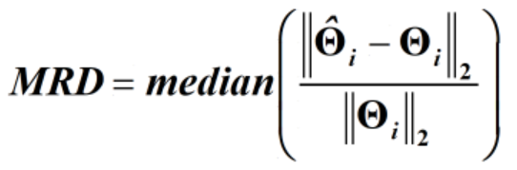
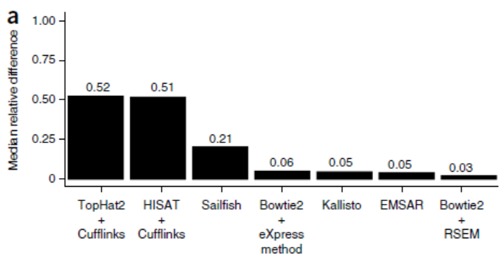
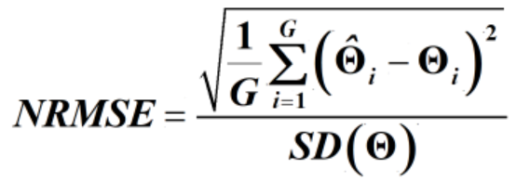
Evaluation metrics
Spearman Correlation Coefficient (SCC) of estimated abundance and ground truth
Median Relative Difference (MRD)
the median percentage of estimated values that deviate from the true ones.
the association between estimated values and their truth ones.
Log2(Estimated TPM+1 )
0 2 4 6 8 10
0 2 4 6 8 10
r=0.97
r=0.44
0 2 4 6 8 10
0 2 4 6 8 10
Bray, Nicolas L., et al. Nature Biotechnology 34(5): 525-527, 2016.
Log2(TrueTPM+1 )
Normalized Root Mean Square Error (NRMSE)
a measure of the extent to which the relationship deviates from a one-to-one linear relationship.

Slide 28
SCC, MRD and NRMSE of different tools
scc
Notes:
IsoQuant and Isotools shows a better performance

Slide 29
SCC, MRD and NRMSE of different protocols
scc
Notes:
cDNA and Captrap shows a better performance than dRNA and R2C2

Slide 30
SCC, MRD and NRMSE of different Platforms
scc
Notes:
Pacbio shows a slightly better performance

Slide 31
MRD versus isoform abundance
MRD
Log2(TPM+1)

Slide 32
Part III.
Evaluation in SIRV set-4 and simulation data

Slide 33
Performance measures for different data types
Different Data Types
Raw real data
Synthetic data
Simulation data
Multiple replicates
(no ground truth)
Cell mixture data
(expected vs observed)
SIRV data
(ground truth is available)
Single replicate data
(ground truth is available)
Statistical measures
Irreproducibility
Correlation
ARR
Consistency
NRMSE
Resolution Entropy
MRD

Slide 34
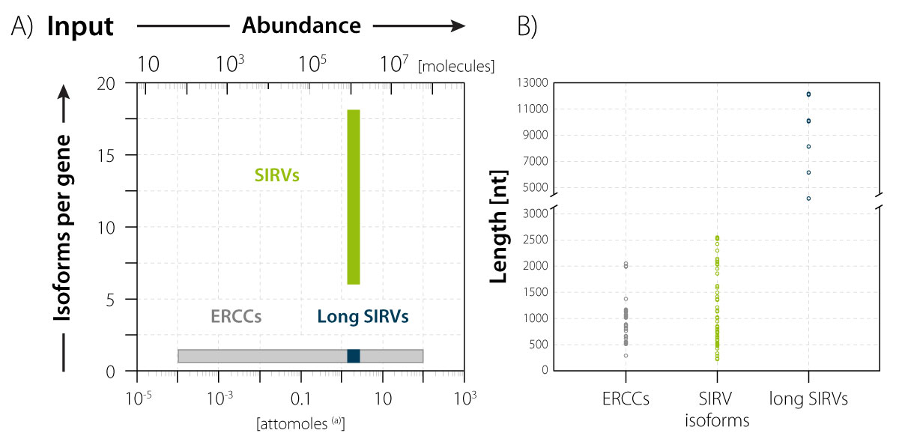
Overview of SIRV set-4 data

Slide 35

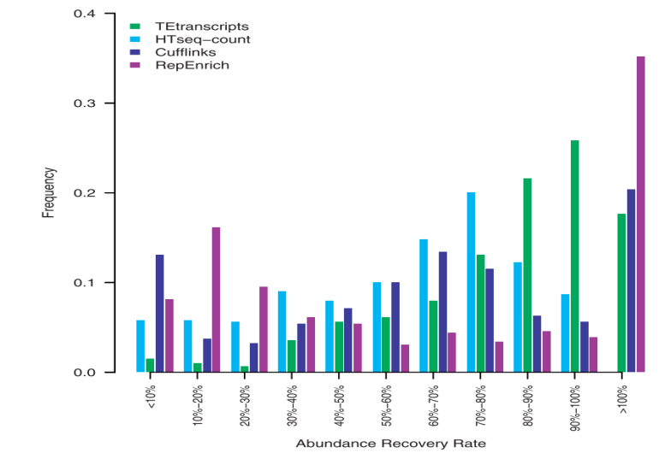
Evaluation metrics
Spearman Correlation Coefficient (SCC) of estimated abundance and ground truth
Median Relative Difference (MRD)
the median percentage of estimated values that deviate from the true ones.
the association between estimated values and their truth ones.
Log2(Estimated TPM+1 )
0 2 4 6 8 10
0 2 4 6 8 10
r=0.97
r=0.44
0 2 4 6 8 10
0 2 4 6 8 10
Bray, Nicolas L., et al. Nature Biotechnology 34(5): 525-527, 2016.
Log2(TrueTPM+1 )
Abundance Recovery Rate (ARR)
Normalized Root Mean Square Error (NRMSE)
the rate of recovered abundances.
a measure of the extent to which the relationship deviates from a one-to-one linear relationship.
Jin, Y.,., et al. Bioinformatics, 31(22), 3593-3599 (2015)

Slide 36
Evaluation in SIRV set-4 data
H1-hESC
Bambu
CapTrap_ONT
CapTrap_PacBio
cDNA_ONT
dRNA_ONT
cDNA_PacBio
R2C2_ONT
IsoQuant
CapTrap_ONT
CapTrap_PacBio
cDNA_ONT
dRNA_ONT
cDNA_PacBio
R2C2_ONT
Estimated abundance
FLAIR
IsoTools
NanoSim
cDNA_ONT
dRNA_ONT
cDNA_PacBio
cDNA_PacBio
cDNA_ONT
dRNA_ONT
FLAMES
RSEM
CapTrap_ONT
CapTrap_PacBio
cDNA_ONT
dRNA_ONT
cDNA_Illumina
True abundance
Notes:
IsoQuant achieves a lower median relative difference for SIRV isoforms
For long SIRV, Nanosim have a higher performance. For ERCC, FLAIR have lower quantification error.
From scatter plot, Isoquant have a very good correlation on the H1-hESC data across different protocols and platforms
FLAIR cDNA ONT and Pacbio correlation
RSEM

Slide 37
Evaluation in SIRV set-4 data
H1-hESC
Frequency
Abundance Recovery Rate (ARR)
ARR
Notes:
This shows the abundance recovery rate. All the methods shows some overestimation and underestimations of SIRV isoforms in different datasets.

Slide 38
Performance measures for different data types
Different Data Types
Raw real data
Synthetic data
Simulation data
Multiple replicates
(no ground truth)
Cell mixture data
(expected vs observed)
SIRV data
(ground truth is available)
Single replicate data
(ground truth is available)
Statistical measures
Irreproducibility
Correlation
ARR
Consistency
NRMSE
Resolution Entropy
MRD

Slide 39
Evaluation in simulation data
Bambu FLAIR IsoQuant Talon/LAPA FLAMES NanoSim IsoTools
Mouse
dRNA_ONT
Mouse
cDNA_PacBio
Log2(Estimated TPM+1)
Human
cDNA_ONT
Human
cDNA_PacBio
Log2(True TPM+1)
Notes:
For simulation data, Isotools achieves a higher spearman correlation coefficicent and isoquant achieves the lowest median relative difference on isoform level.
Scatter plots shows the IsoQuant achieves a good correlation in all four simulation datasets.
FLAIR have a very correlation in cDNA pacbio datasets with human and mouse

Slide 40
Evaluation in simulation data
Abundance Recovery Rate (ARR)
Frequency
ARR
Notes:
IsoQuant IsoTools,have the highest percentage of isoforms with ARR between 90%-100%.

Slide 41
MRD versus isoform abundances
MRD
Log2(TPM+1)

Slide 42
Acknowledgements
The LRGASP Evaluation Team
Kin Fai Au, Dingjie Wang and Haoran Li (Challenge 2 evaluators)
Ana Conesa and Fran Pardo (SQANTI developers)
Gloria Sheynkman (experimental validation lead)
Adam Frankish and Jane Loveland (GENCODE)
Mark Diekhans (UCSC Genome Browser)
The LRGASP Participant Team
FLAIR Team
Talon/LAPA Team
FLAMES Team
Bambu Team
IsoQuant Team
IsoTools Team
NanoSim Team

